Slide 1
Akhil R Nair(Leader) Nithin K Shine 62383-74626 75107-28766
HackX Team : Techy Titans
Sradha N 94000-60273
This Photo by Unknown Author is licensed under CC BY-SA
Sarath Krishna C Jayant Dadhich 86101-32762 95499-46415
Domain:open innovation
Problem statement:Inabilty of current user interface (UI) to keep up with the growing 3-d applications
This Photo by Unknown Author is licensed under CC BY-SA

Slide 2
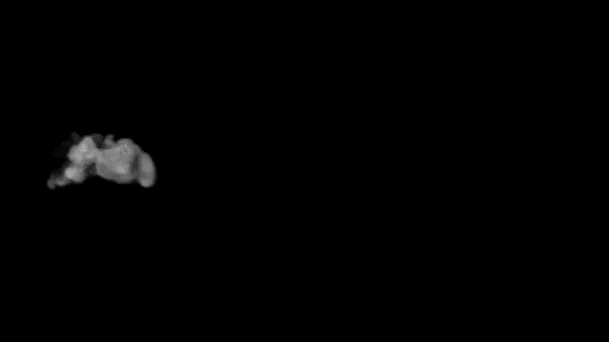
Touchless 3D Tracking Interface

Slide 3
Abstract
The whole project is based on the idea on length of time it takes a capacitor to charge, based on this charging time the distance and other related values and coordinates are measured and the motion path is calculated. The main objective of the project is Touchless 3D tracking, as the name suggests the project focuses on detection of 3D motion without any external touch and replicate the same motion on our computer screen. That is, the computer should be able to detect the entire motion path of the desired object. The Tracking takes place in 3 Dimensional field that is x,y and z, that is the depth is also taken into consideration. Each axis acts like a capacitor when the voltage is applied to it. As our hand approaches the plate our body electrically couples with the plate and changes its capacitance. The higher the capacitance the longer it will take for the capacitor to get fully charged. The software on the Arduino measures the time it takes to charge the plates. The change in the charge time corresponds to the hands distance from the plate. The Whole project is based on Arduino Micro-controller, which is an open source microcontroller. The project will be implemented on Arduino platform, which provides direct interaction with the Arduino micro-controller. The simplicity of this 3D tracking mechanism will show us, what all are the possibilities for future and what all can be achieved using some simple and logical techniques

Slide 4
we are designing an app/web application to display the current 3-D position. we are doing 3-d tracking in one particular area and the result can be obtained anywhere.it includes internet of things(iot)and it can be used very easily.
Novelty
Technology Stack
We are using Arduino IDE for coding implementation. We are using HTML and c,c++ as primary languages.

Slide 6
Referring to the schematic, connect the resistors to the three inner wires of the cables as shown and connect this to the ends of the three wires. The 220KΩ resistors all connect between the inner wire of the cable and 5V. The 10KΩ resistors will each be connected between the end of the cable and a pin on the Arduino. The circled area indicates that this wire should be shielded, with the shield connected to +5V.
Use a small piece of jumper wire to make the connection between the shield wires and the 5V output pin on the Arduino, as shown in the third photo. Connect each of the 10KΩ resistors to pins 8,9, and 10 respectively. Connect the red wire to the +5V pin on the Arduino.
Attach each of the alligator clips to a foil plate. The clips should be attached in the following order: pin 8=left plate (x), pin 9=bottom plate (y), pin 10=right plate (z). Make sure that each clip is making good electrical contact with the foil and is only touching one plate.
When troubleshooting, check the connection between the plate and the pin with a multimeter to make sure the alligator clip is making a good electrical contact.

Slide 7
The Arduino boards feature serial communications interfaces, including Universal Serial Bus (USB) , which are also used for loading programs. The microcontrollers can be programmed using the C and C++ programming languages, using a standard API which is also known as the "Arduino language". In addition to using traditional compiler toolchains, the Arduino project provides an integrated development environment (IDE) and a command line tool. Arduino IDE(1.8.13) is used in this project.

Slide 8
Business scope
There are 3 major areas of technology where the canny UI-3D designer is making major differences today and will be doing so for a good while into the future too.Video Games3D UI-3D have opened up a whole world of possibility in gaming; they can create the most compelling user experiences because they allow the gamer to become one with the action – rather than manipulating that action from a far.Very Large Displays Touch screens are a limited solution too. They’re OK when the user can reach the whole screen but that’s not likely to be very easy on a giant screen at a One Direction Concert. UI-3D which allows the user to interact with the screen in 3D – such as simple hand gestures; can make this problem mch simpler to resolve.Mobile ApplicationsNot all 3D UI-3D users are for the large screen; there’s as much a need for clever 3D UI-3D controls on the other end of things. Mobile devices are built for 3D complexity; they contain GPS, gyroscopes, accelerometers and dozens of other clever controls (such as cameras for accurate 3D positioning of a user or other individual near the equipment). The increasing use of biometric equipment in the automobile, consumer electronics, commercial, and industrial sectors is expected to drive the growth of the touchless biometric equipment market. As biometric deployments begin to expand into markets and environments that are characterized by end-users who may possess less ideal skin conditions to use fingerprint technology, contactless biometric sensor technology is proving to be a viable solution. Fingerprint technology is not a one-size-fits-all solution due to its reliance on skin integrity and difficulty to function properly in certain environments and with various ethnicities. Contactless biometric sensors help in solving these problems and offer added features of being more hygienic, a problem that plagues biometric technology with sensors that require contact.
THANK YOU!

